Slide 1
Hydrology signature in superconducting gravimeter readings
Jiaxin Liu
Philipp Schollmeier
February 7th, 2023, Stuttgart

Slide 2
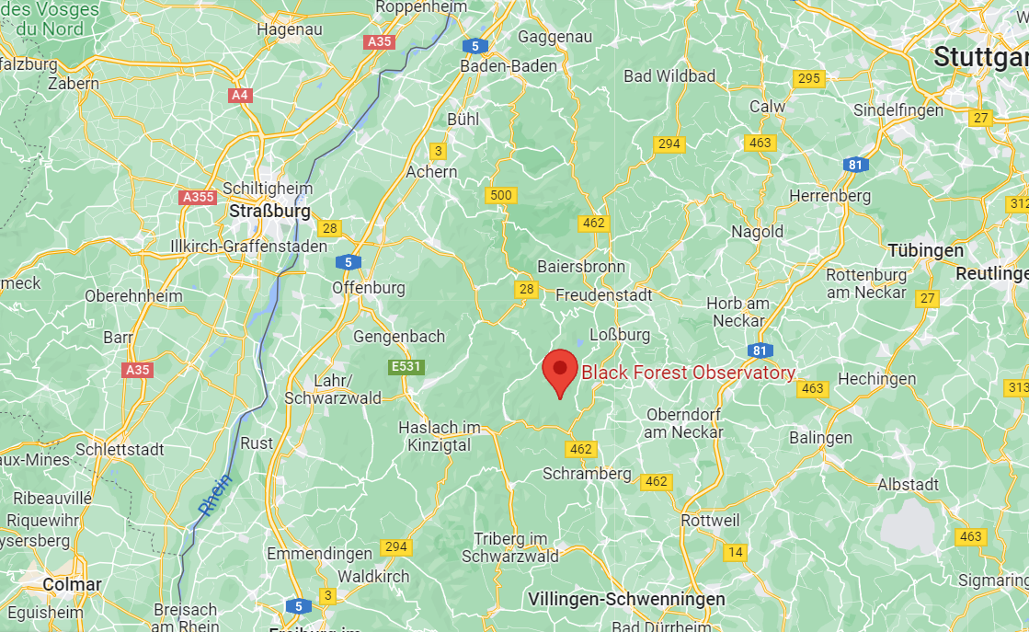
Measurement site
Fig. 1: Location of the BFO (Google Maps)
Black Forest Observatory near the village of Schiltach
Notes:
-In a remote location with few human sources of noise
-Granite bedrock -> less movement of ground with changing pressure

Slide 3
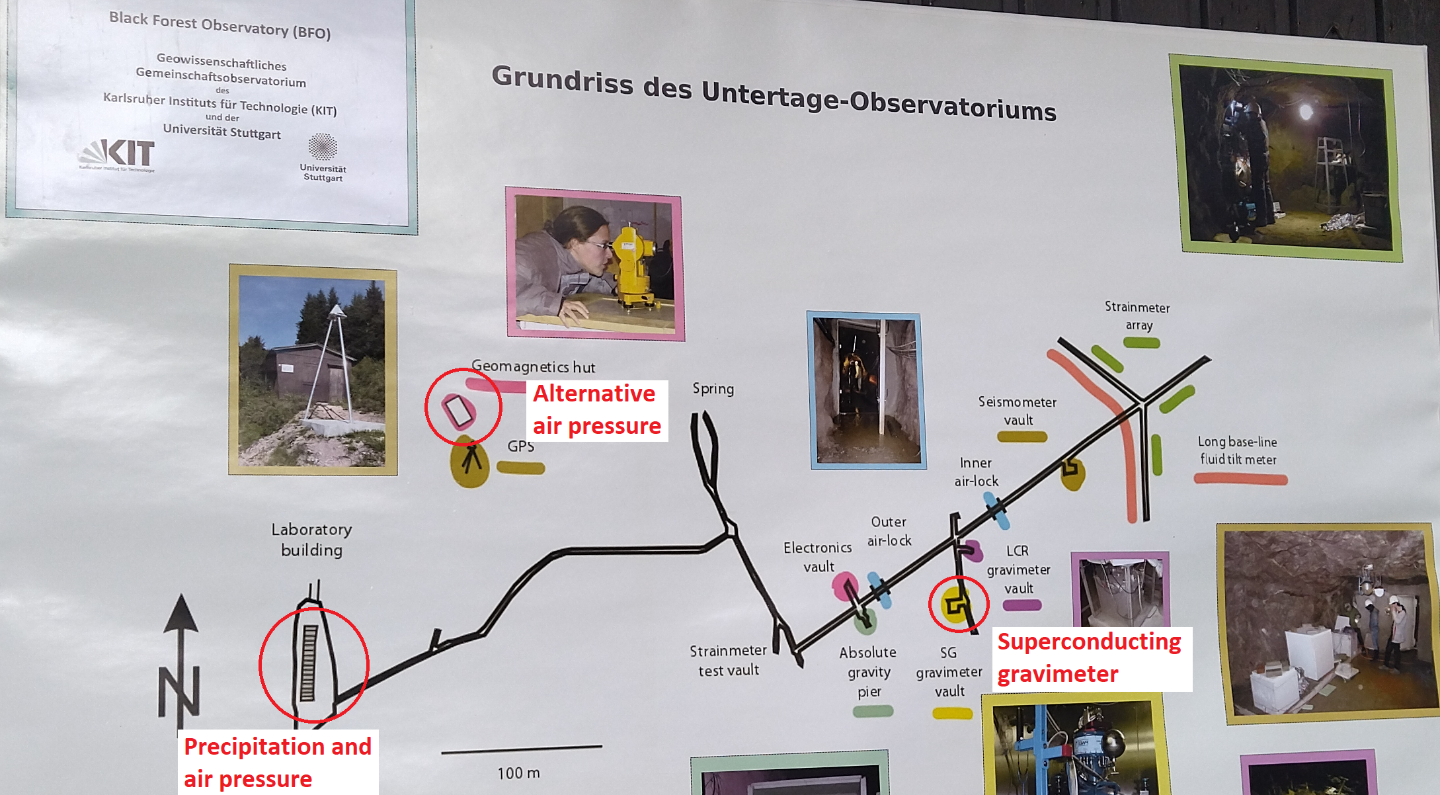
Measurement site
Fig. 2: Layout of the BFO (own picture)
SG in an old silver and cobalt mine
About 100 m under the surface
Notes:
-BFO is at the edge of a valley with a small creek, SG about 500 m inside mountain
-Stable temperature of around 8°C inside, air locks provide fairly stable pressure
-Not included in graphic are soil moisture probes

Slide 4
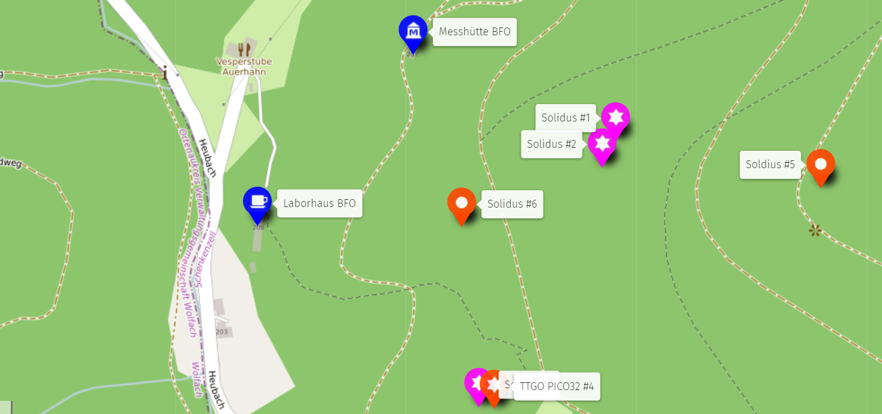
Mesurement site
Fig. 48: Soil moisture probes at the BFO

Slide 5
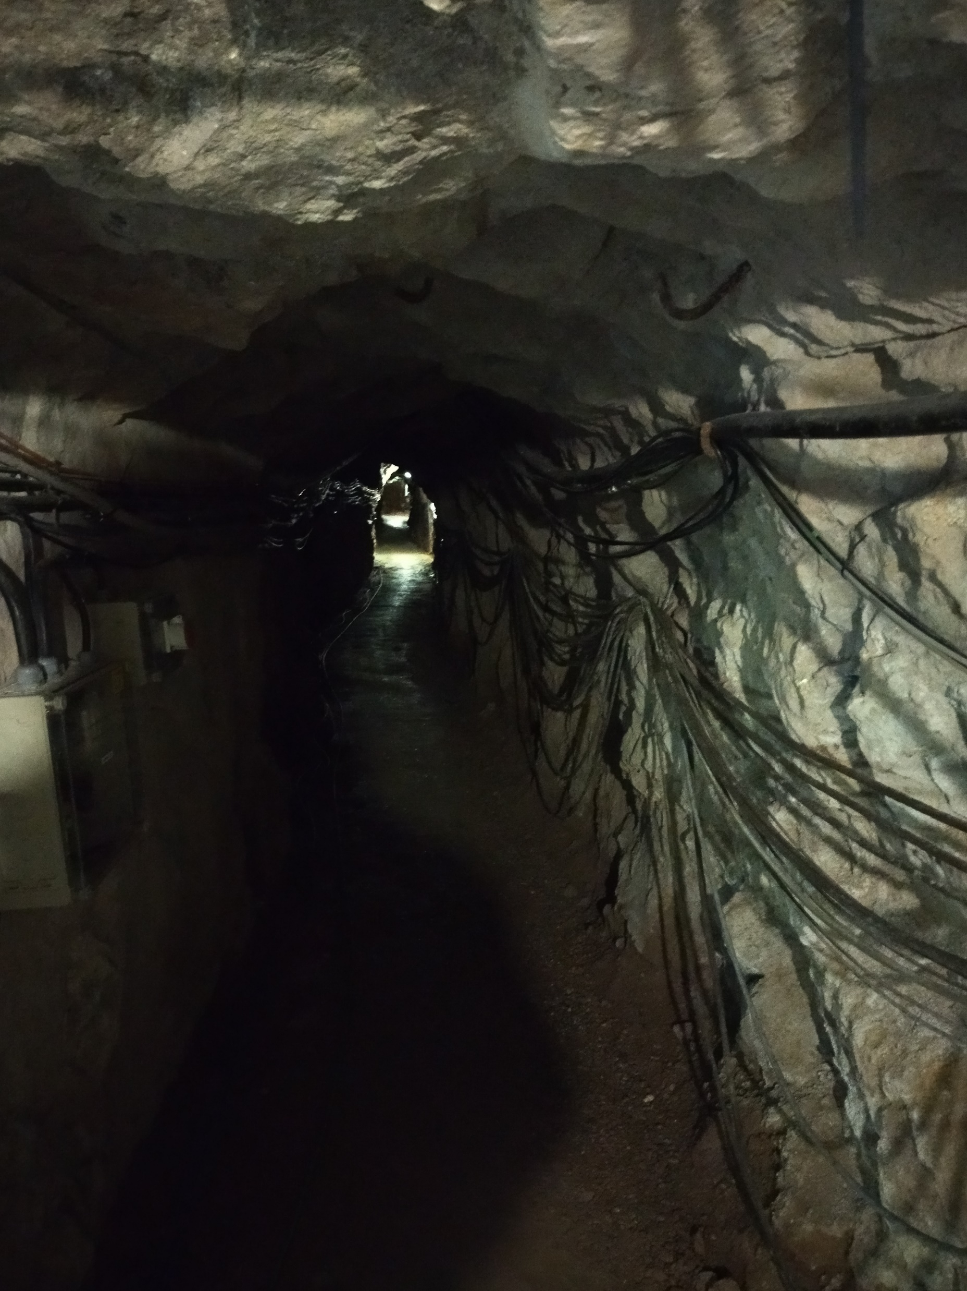
Measurement site
Fig. 3: Tunnel of the mine (own picture)
Notes:
- One of the cables connect SG and outside pressure sensor

Slide 6
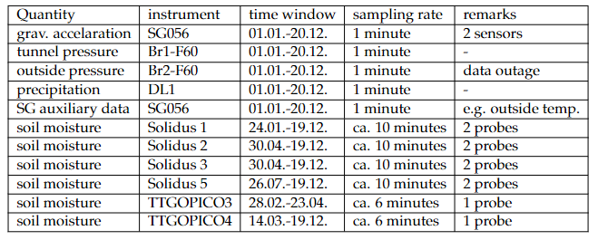
Data
Fig. 4: Overview of available data
All data are from 2022
Two sensors of the superconducting gravimeters SG056 – G1-F60 and G2-F60, vertical offset of 20 cm between them
Notes:
- RELATIVE measurements of gravity!

Slide 7
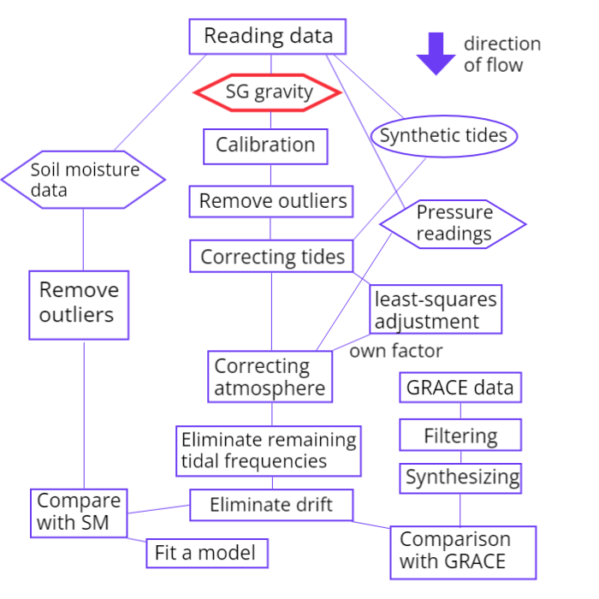
Workflow

Slide 8
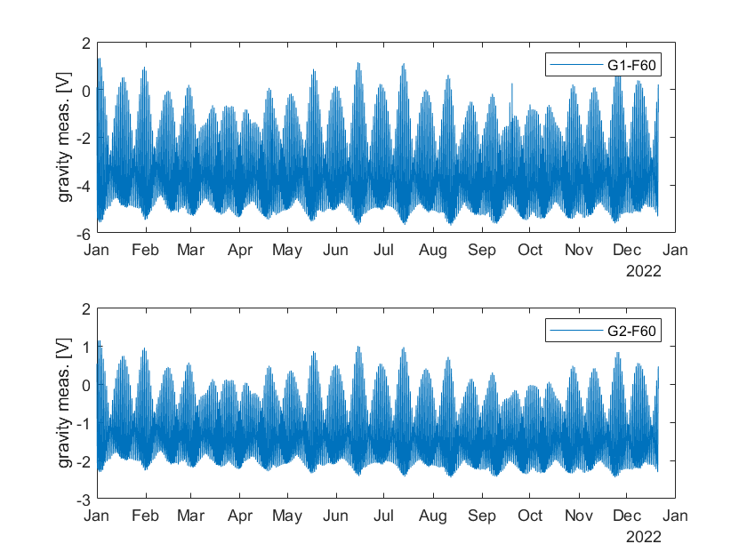
Data
Fig. 5: Uncalibrated gravity measurements of both sensors
Notes:
Outliers at G1-F60 in September
Different magnitudes of voltage

Slide 9
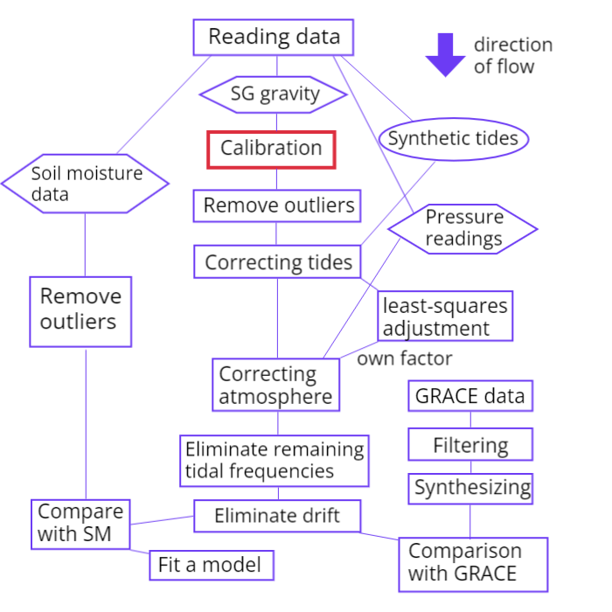
Calibration

Slide 10
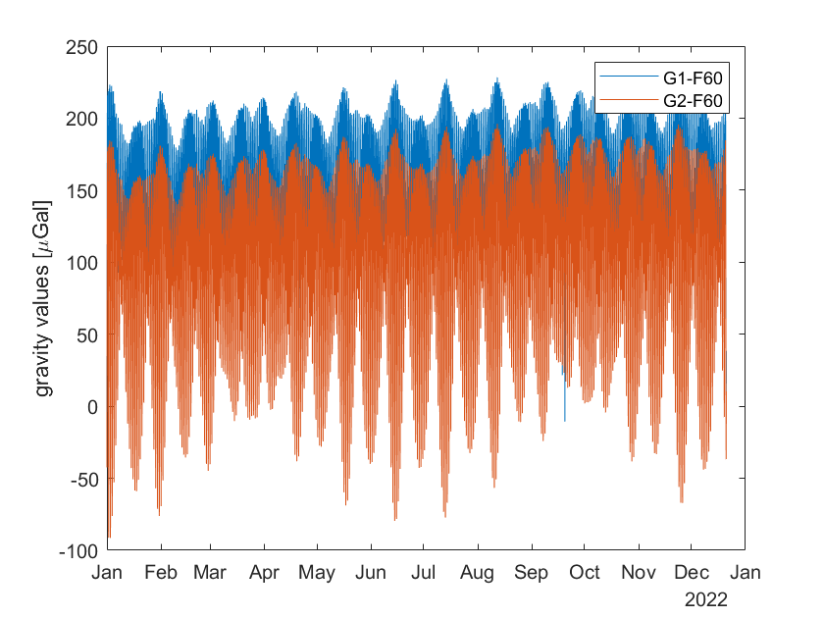
Calibration
Fig. 6: Calibrated measurements of both sensors
Given calibration coefficients for both sensors

Slide 11
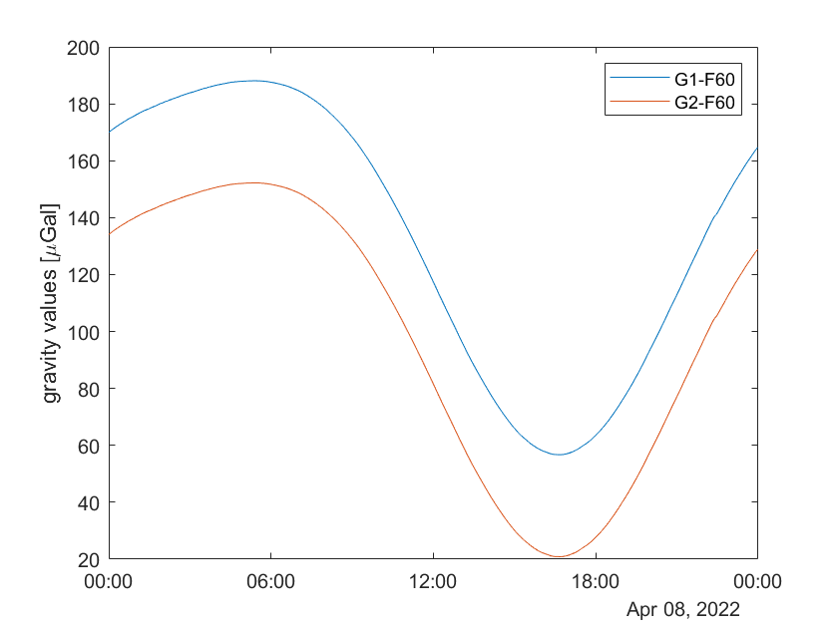
Calibration
Fig. 6: Calibrated measurements on April 8th

Slide 12
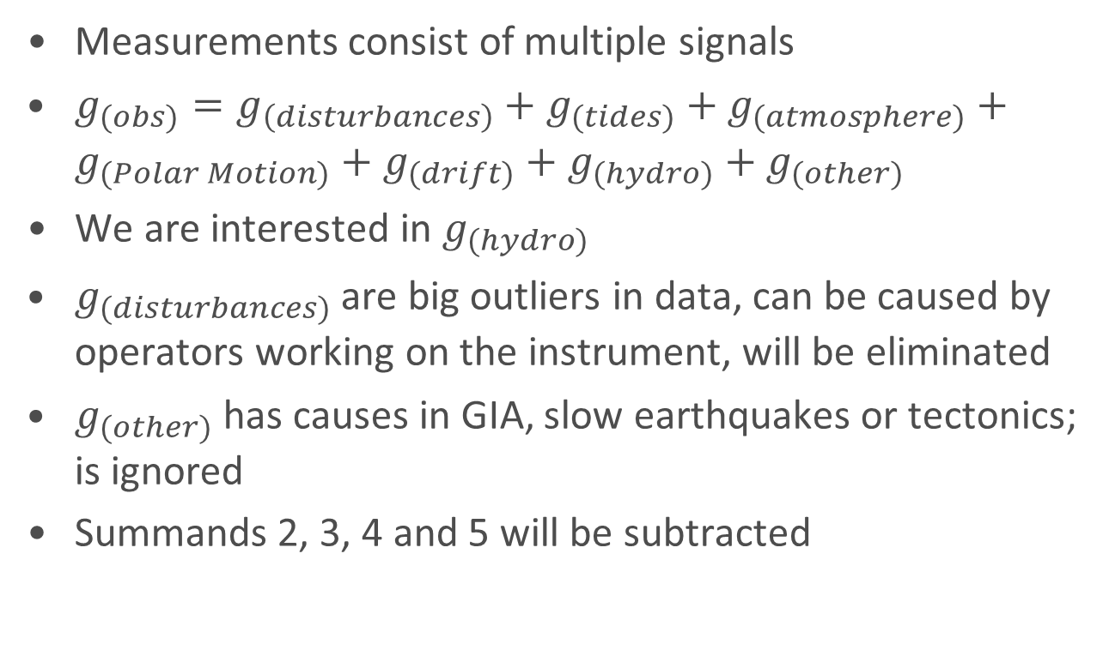
Corrections
Measurements consist of multiple signals
$g_{(obs)}=g_{\left(disturbances\right)}+g_{(tides)}+g_{(atmosphere)}+g_{(Polar Motion)}+g_{(drift)}+g_{(hydro)}+g_{(other)}$
We are interested in $g_{(hydro)}$
$g_{(disturbances)}$ are big outliers in data, can be caused by operators working on the instrument, will be eliminated
$g_{(other)}$ has causes in GIA, slow earthquakes or tectonics; is ignored
Summands 2, 3, 4 and 5 will be subtracted

Slide 13
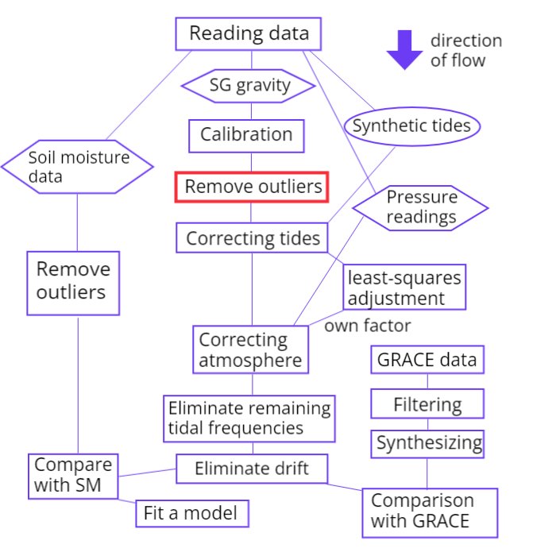
Corrections

Slide 14
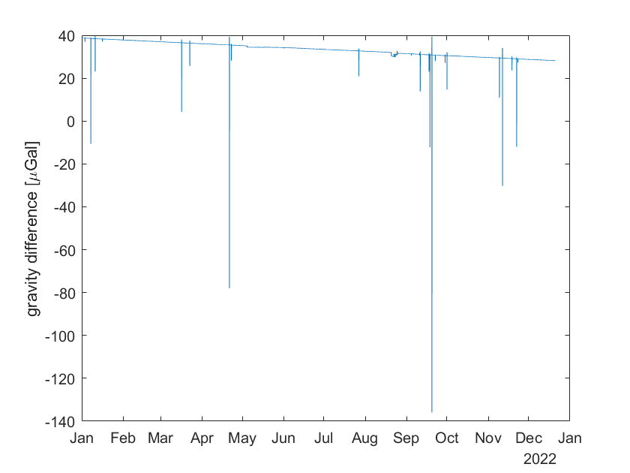
Removing outliers
Fig. 7: Differences between two sensors before outlier filtering

Slide 15
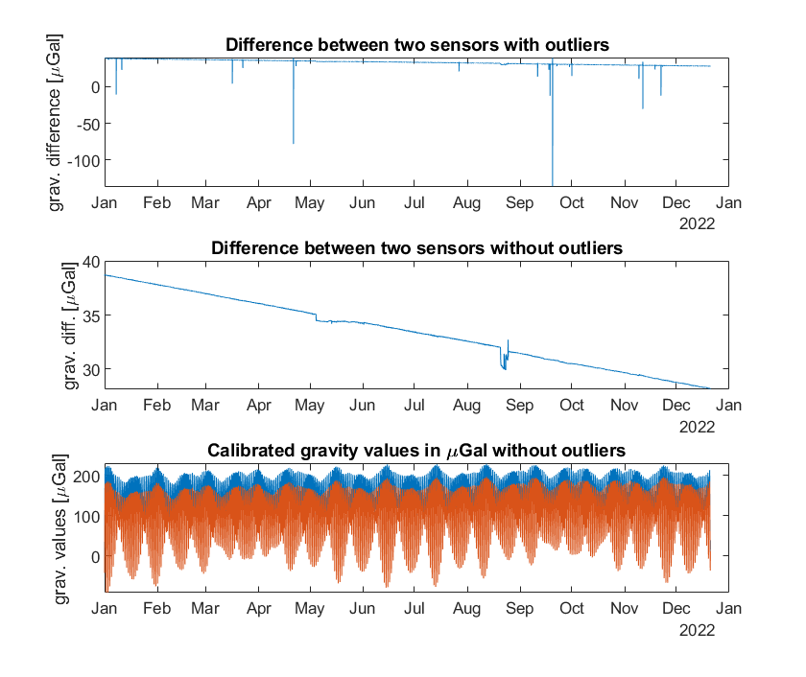
Removing outliers
Fig. 8: Removing outliers

Slide 16
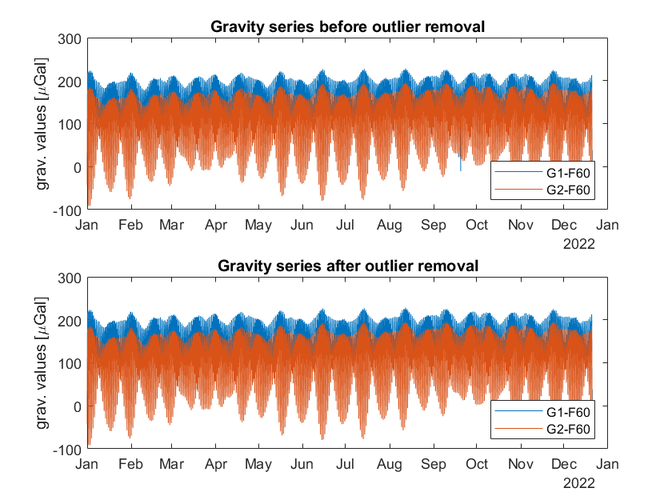
Removing outliers
Fig. 9: Comparison of gravity series before and after outlier removal

Slide 17
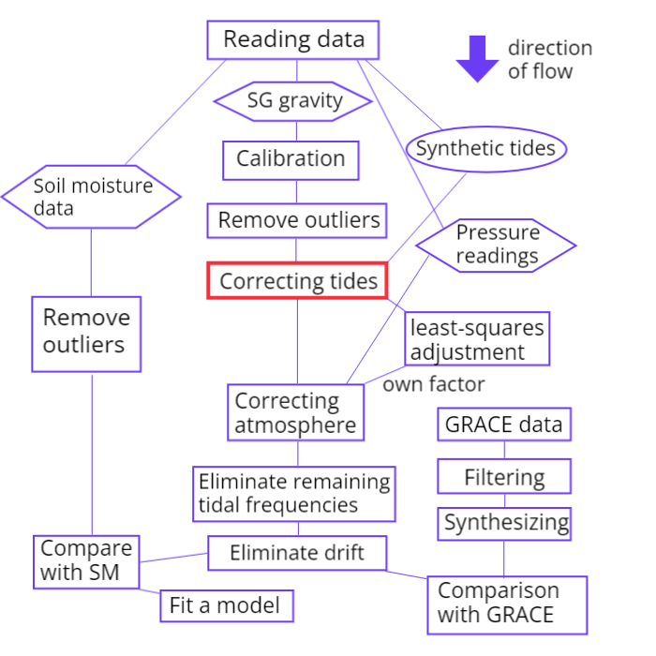
Tides

Slide 18
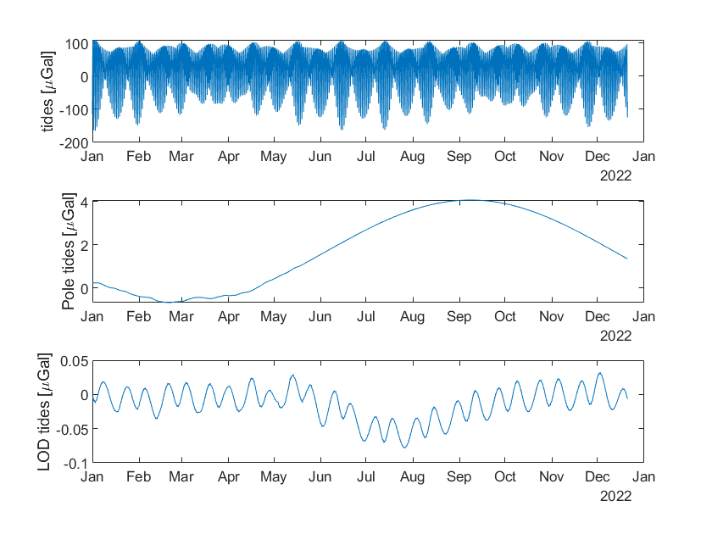
Tides
Fig. 10: Synthetic tides
Notes:
- Pole tide: Chandler period (400 days)

Slide 19
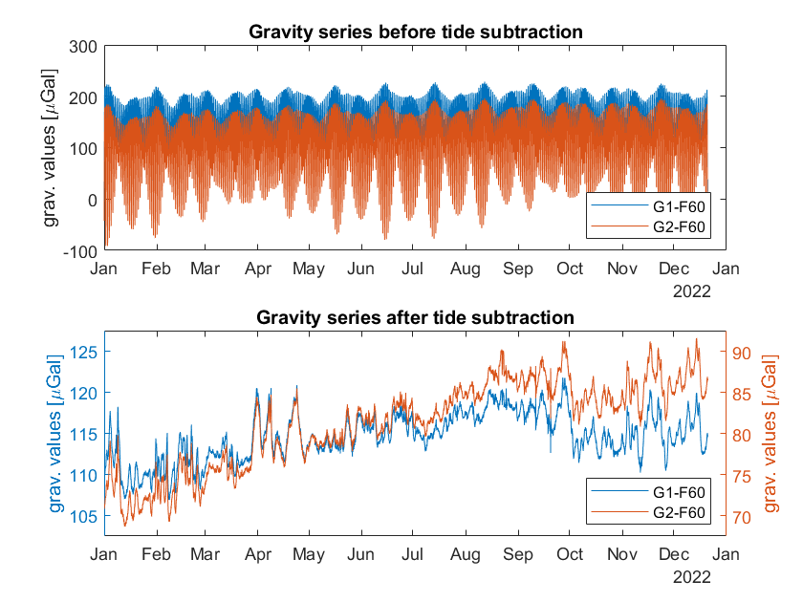
Tides
Fig. 11: Tide subtraction

Slide 20
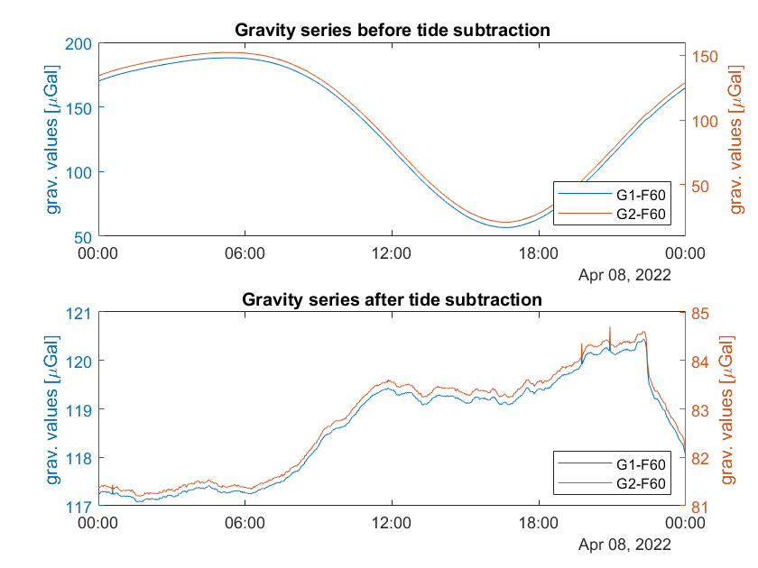
Tides
Fig. 12: Tide subtraction on Apr 8th

Slide 21
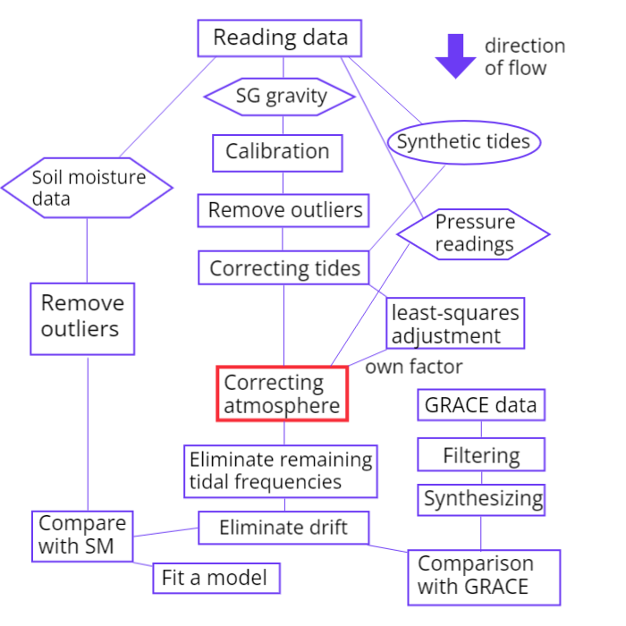
Atmospheric pressure

Slide 22
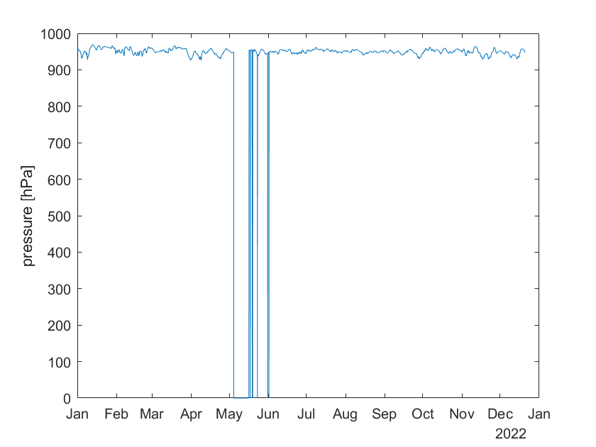
Atmospheric pressure
Fig. 13: Outside pressure series over the year
Notes:
- Data gaps because of interrupted connection between SG and pressure gauge after a storm

Slide 23
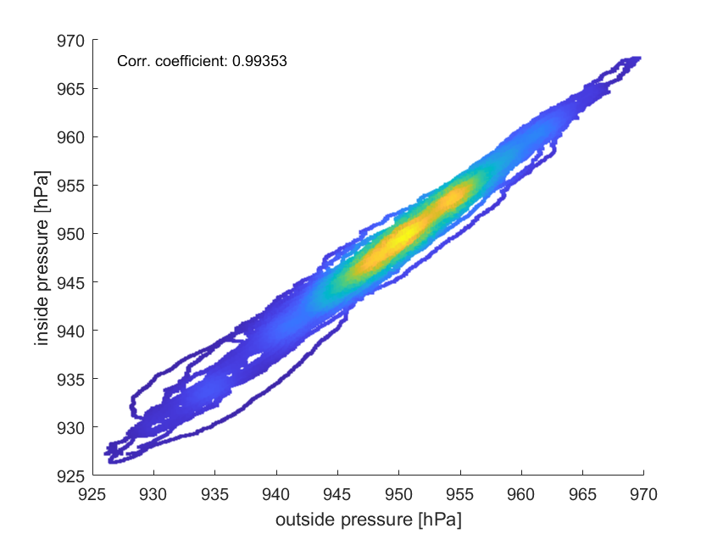
Atmospheric pressure
Fig. 14: Density scatter plot between inside and outside pressure

Slide 24
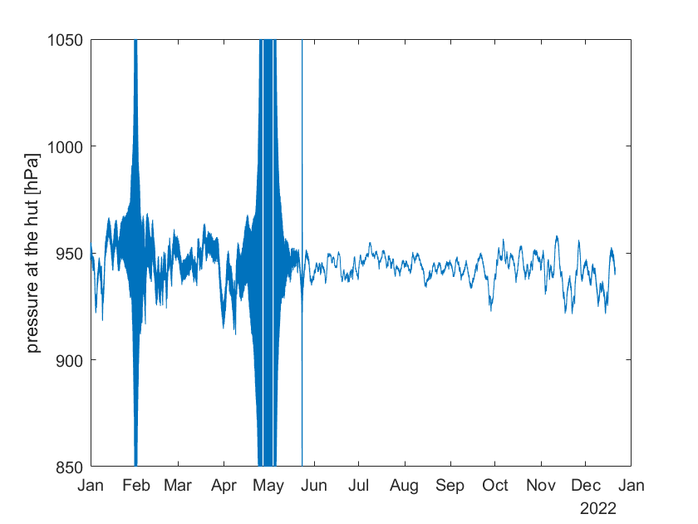
Atmospheric pressure
Fig. 15: Pressure series at the hut

Slide 25
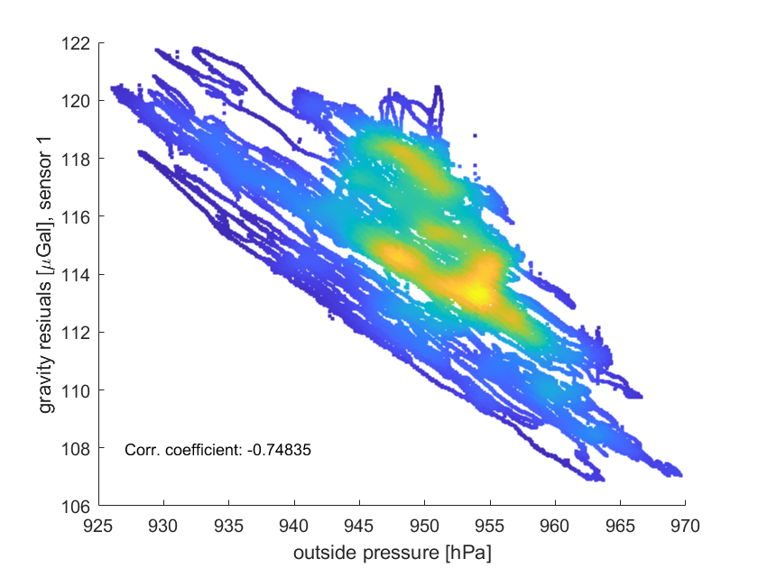
Atmospheric pressure
Fig. 17: Density scatter plot between outside
pressure and gravity residuals
Notes:
- Mention correlation coefficient

Slide 26
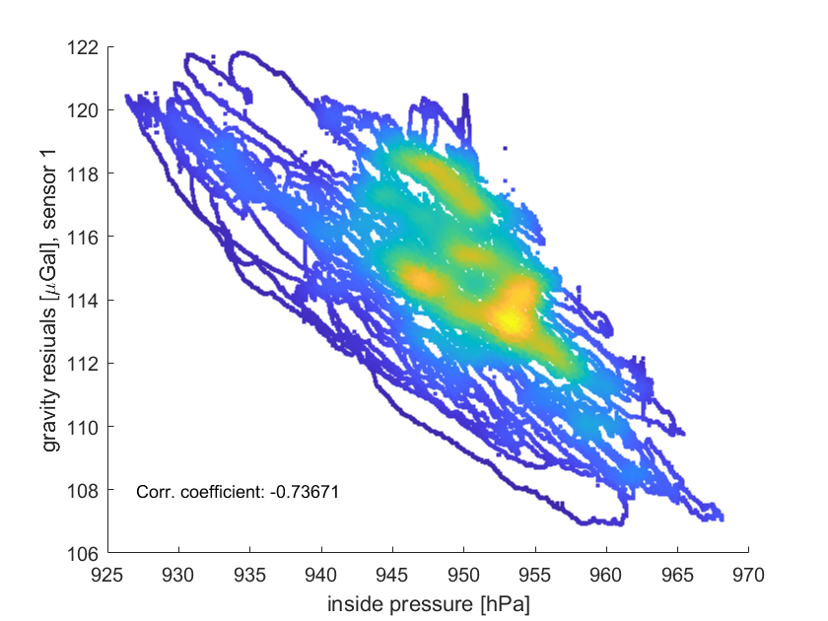
Atmospheric pressure
Fig. 18: Density scatter plot between inside
pressure and gravity residuals
Notes:
- Mention correlation coefficient

Slide 27
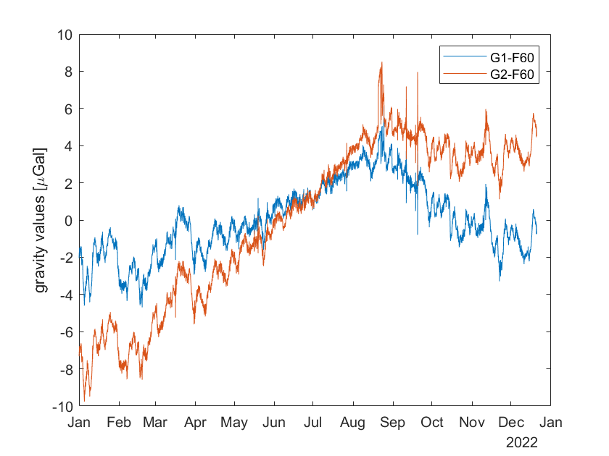
Atmospheric pressure
Fig. 19: Gravity residuals after pressure correction, gaps filled
by inside pressure

Slide 28
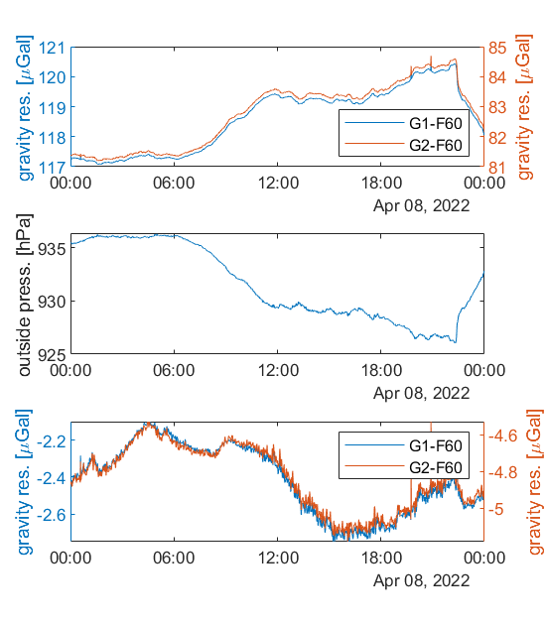
Atmospheric pressure
Fig. 21: Gravity residuals on April 8th before and after atmospheric correction

Slide 29
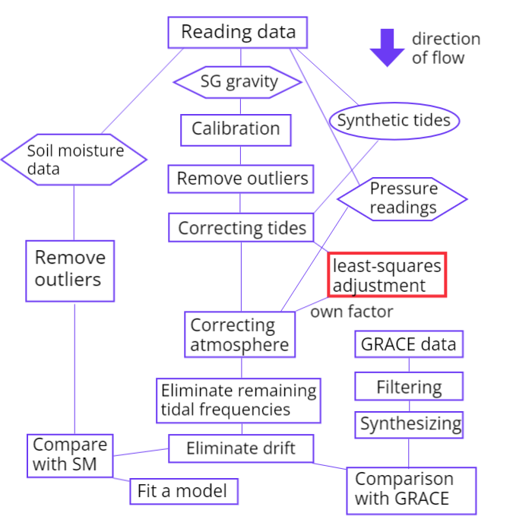
Atmospheric factor

Slide 30
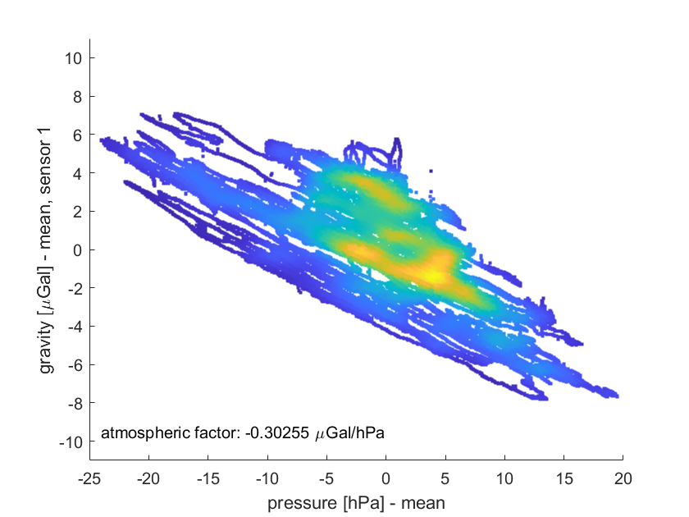
Atmospheric factor
Fig. 22: Density scatter plot between outside pressure and gravity residuals of sensor 1, without drift correction

Slide 31
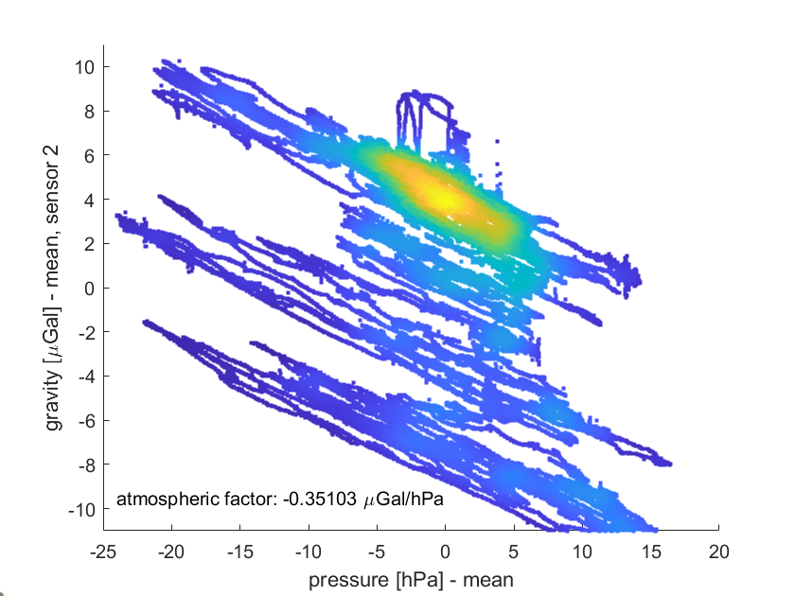
Atmospheric factor
Fig. 23: Density scatter plot between outside pressure and gravity residuals of sensor 2, without drift correction

Slide 32
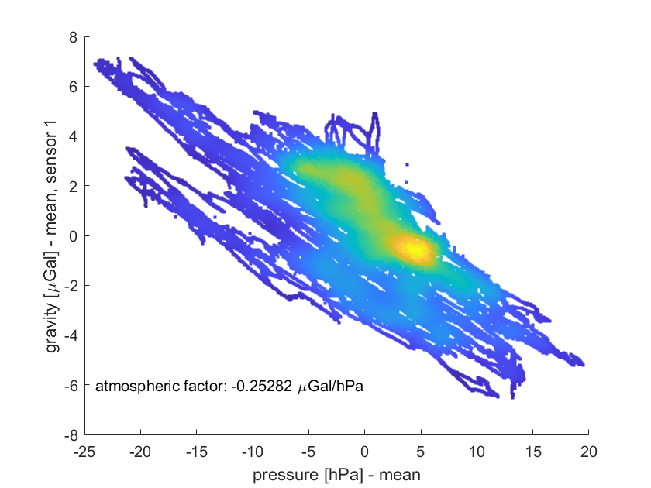
Atmospheric factor
Fig. 24: Density scatter plot between outside pressure and gravity residuals of sensor 2, with drift correction

Slide 33
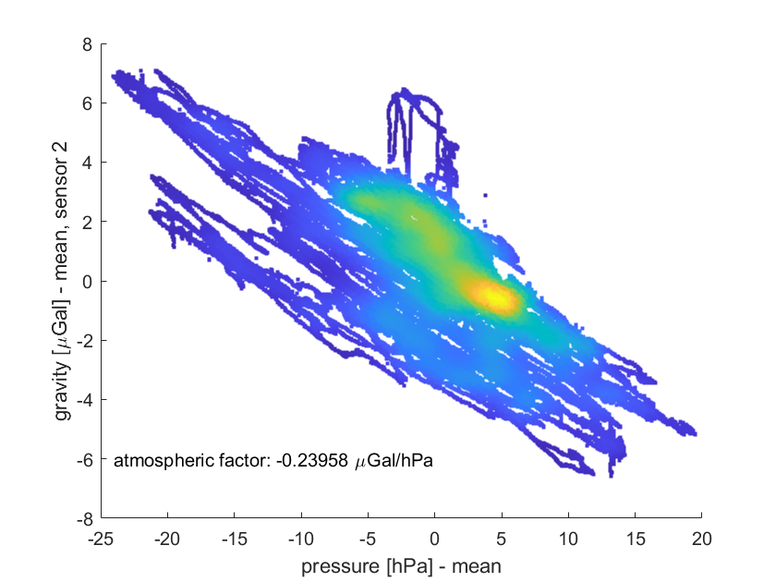
Atmospheric factor
Fig. 25: Density scatter plot between outside pressure and gravity residuals of sensor 2, with drift correction

Slide 34
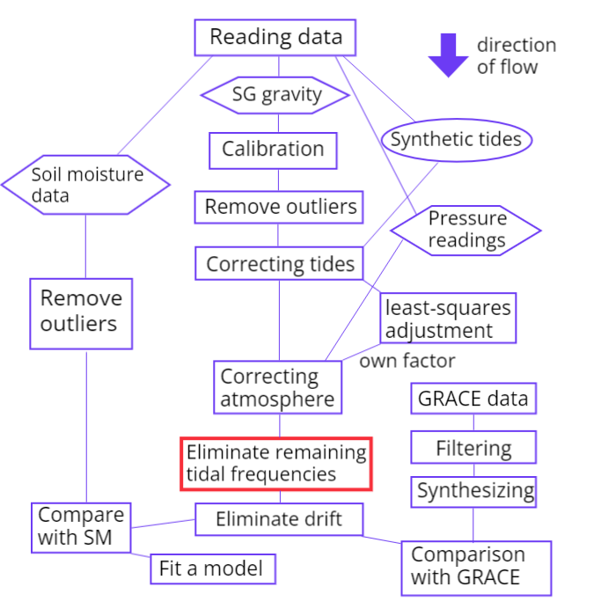
Remaining frequencies

Slide 35
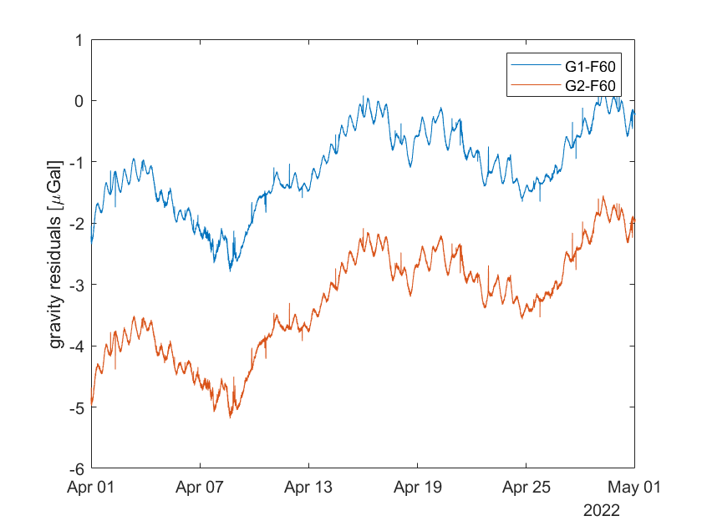
Remaining frequencies
Fig. 26: Gravity residuals of both sensors in April after removing atmospheric influence
Notes:
Frequencies with small amplitudes, especially tidal, are still visible
Load tides are not removed perfectly, parameters were estimated for a longer period

Slide 36
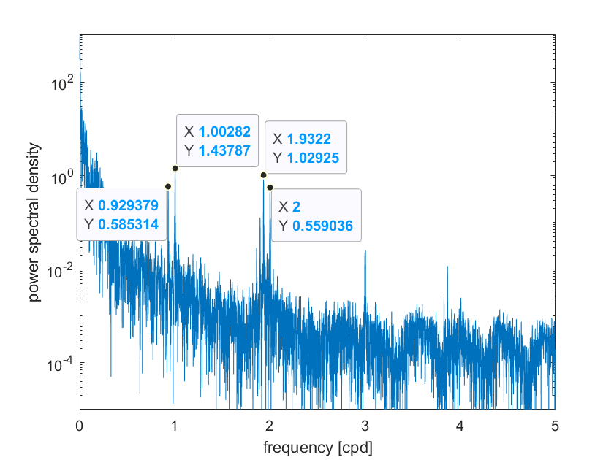
Remaining frequencies
Fig. 27: Lomb-scargle analysis of gravity series of sensor 1, biggest peaks marked
Lunar day = 0.966 cpd, half lunar day = 1.933 cpd

Slide 37
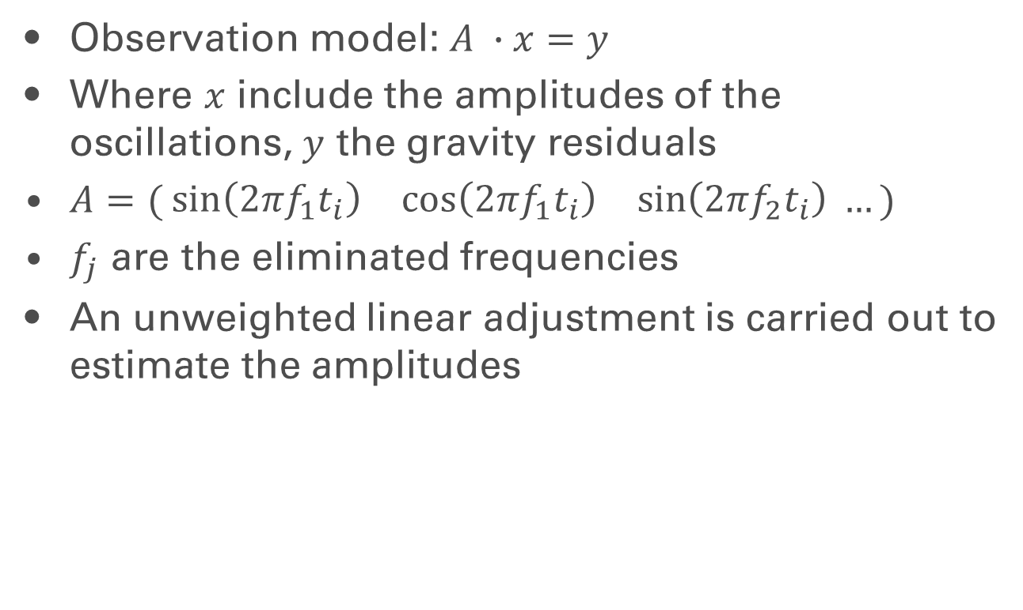
Remaining frequencies
Observation model: $A ∙x=y$
Where $x$ include the amplitudes of the oscillations, $y$ the gravity residuals
$A=( \begin{matrix}\sin\left(2πf_{1}t_{i}\right) & \cos\left(2πf_{1}t_{i}\right) & \sin\left(2πf_{2}t_{i}\right)\end{matrix} …)$
$f_{j}$ are the eliminated frequencies
An unweighted linear adjustment is carried out to estimate the amplitudes

Slide 38
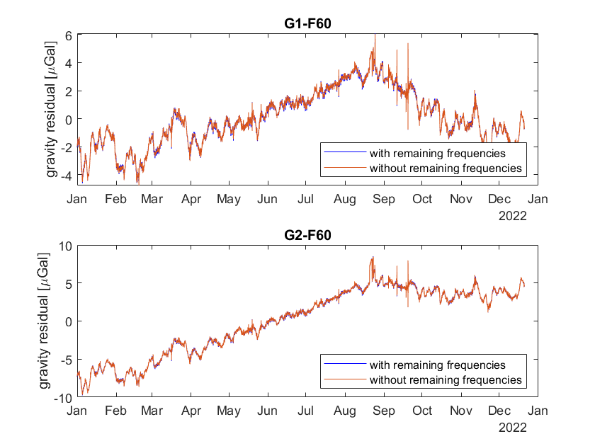
Remaining frequencies
Fig. 28: Gravity series before and after frequency elimination
Eliminated frequencies: 1 day, 1 lunar day, ½ day, ½ lunar day

Slide 39
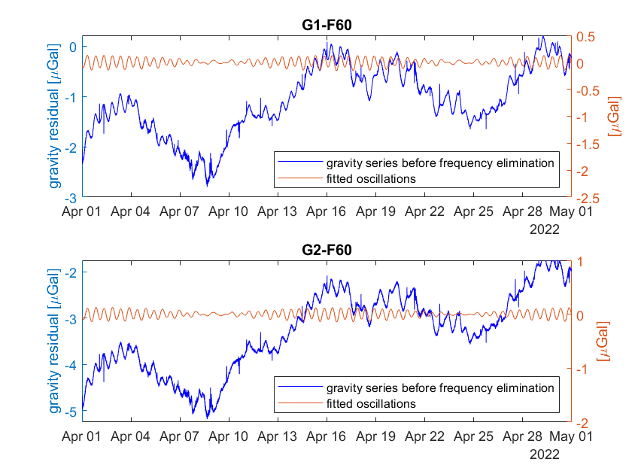
Remaining frequencies
Fig. 29: Fitted Oscillations in April

Slide 40
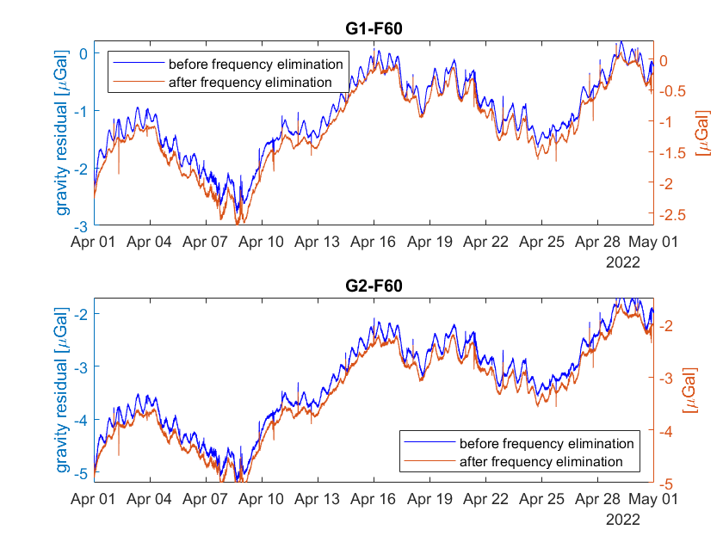
Additional slides - Remaining frequ.
Fig. 30: Comparison of gravity series before and after frequency elimination

Slide 41
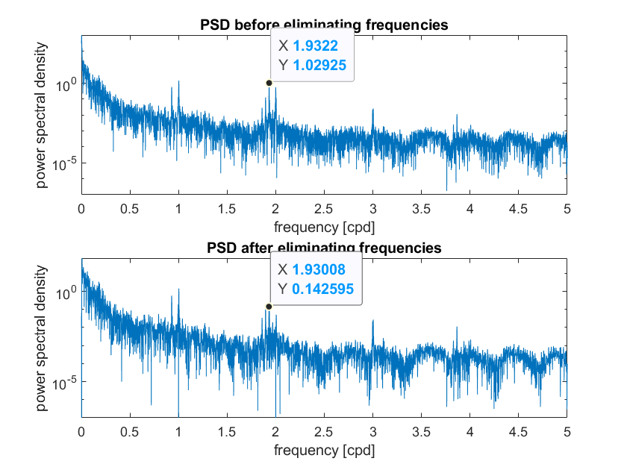
Remaining frequencies
Fig. 31: Comparison of PSDs before and after frequency elimination

Slide 42
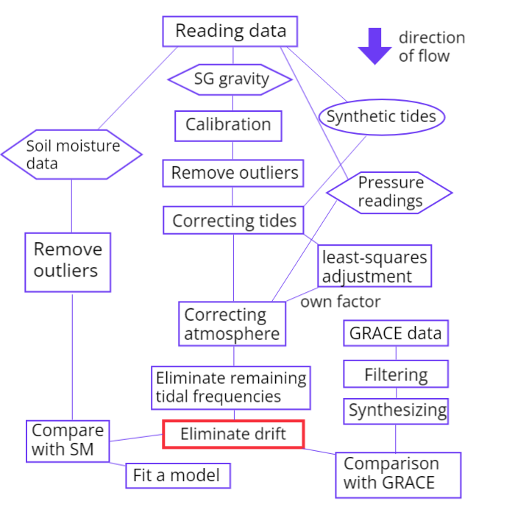
Removing drift

Slide 43
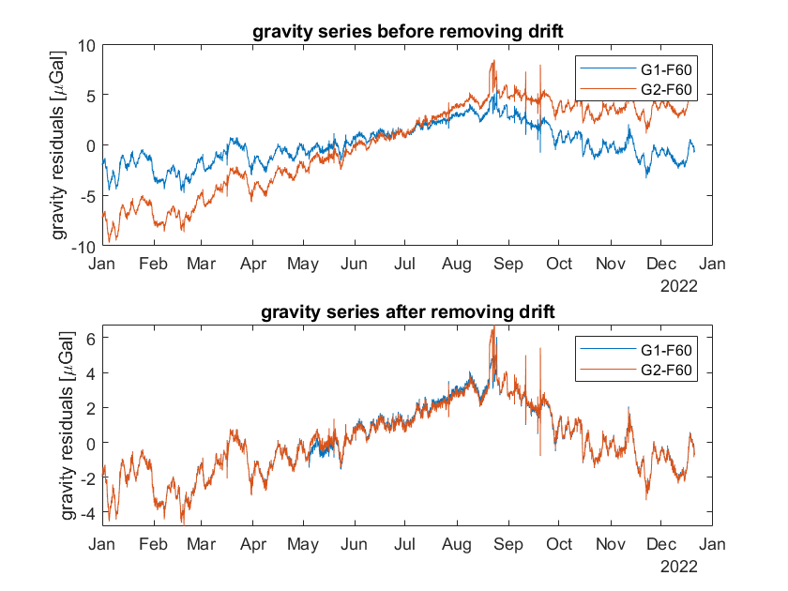
Removing drift
Fig. 32: Gravity series before and after removing drift

Slide 44
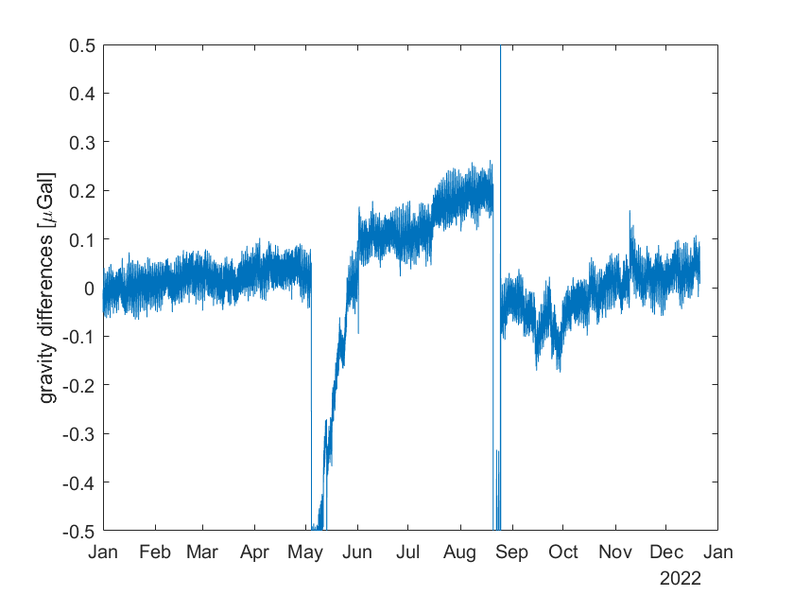
Differences between sensors
Fig. 33: Differences between sensors after all corrections

Slide 45
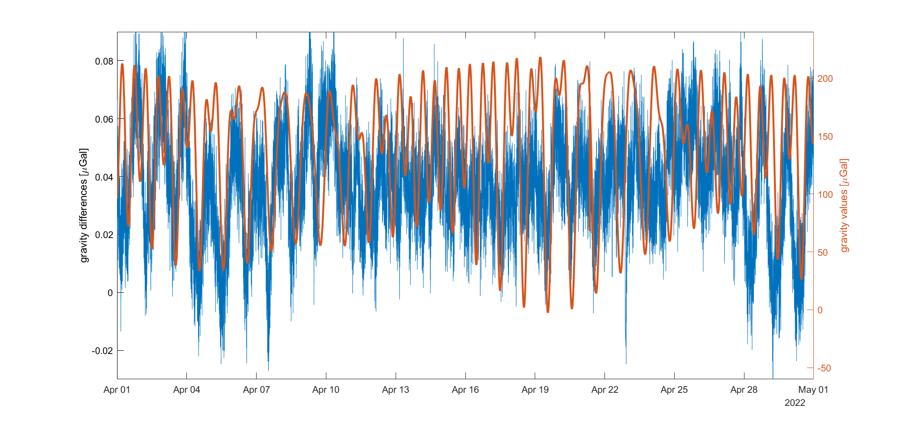
Differences between sensors
Fig. 34: Comparison between the differences and original readings of sensor 1

Slide 46
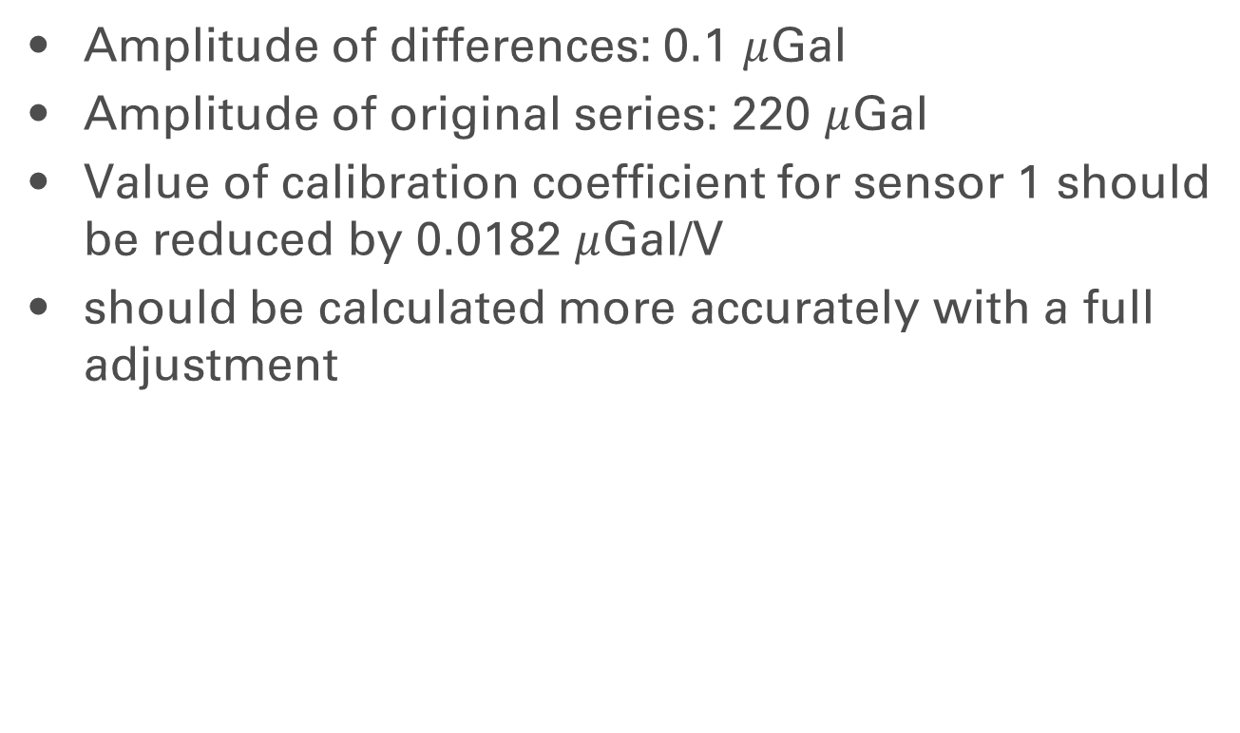
Differences between sensors
Amplitude of differences: 0.1 $μ$Gal
Amplitude of original series: 220 $μ$Gal
Value of calibration coefficient for sensor 1 should be reduced by 0.0182 $μ$Gal/V
should be calculated more accurately with a full adjustment

Slide 47
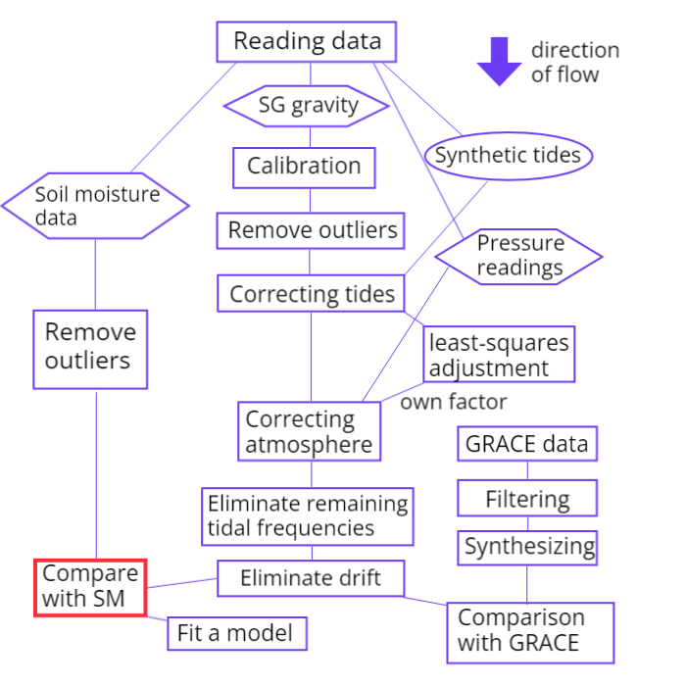
Hydrology

Slide 48
Mesurement site
Fig. 48: Soil moisture probes at the BFO

Slide 49
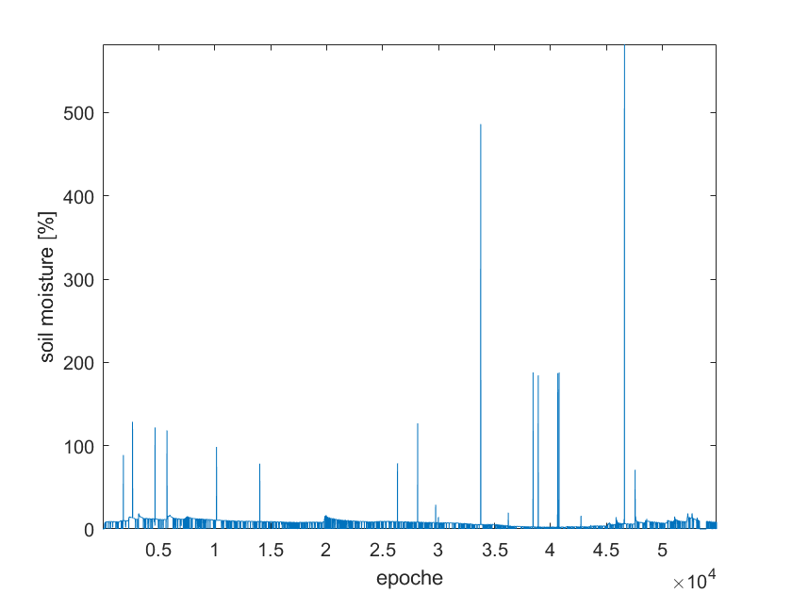
Hydrology
Fig. 35: Recorded soil moisture over the year (Solidus 1, probe 0)
Includes many outliers -> filtering, linear interpolation

Slide 50
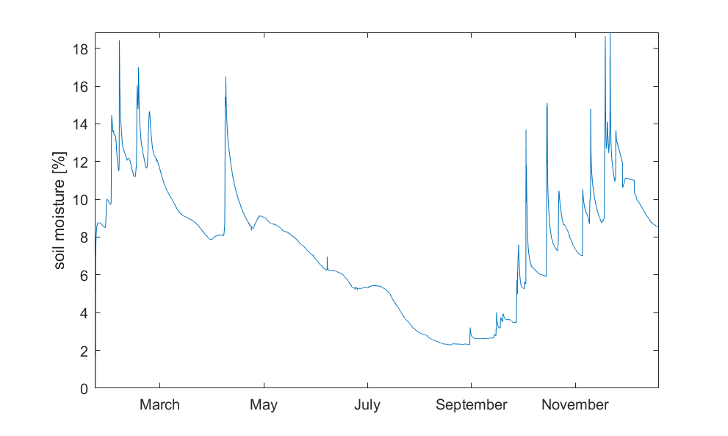
Hydrology
Fig. 36: Soil moisture series after outlier removal (Solidus 1, Probe 0)

Slide 51
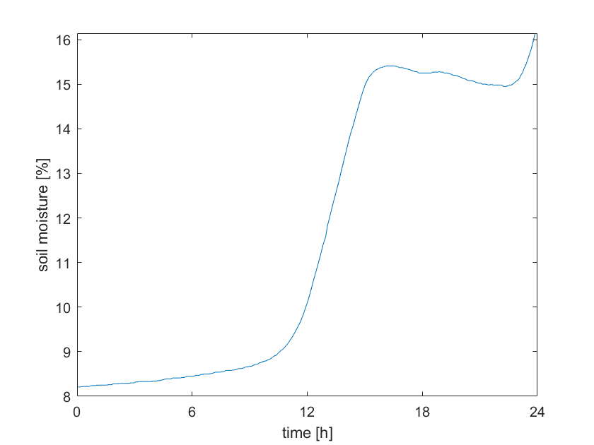
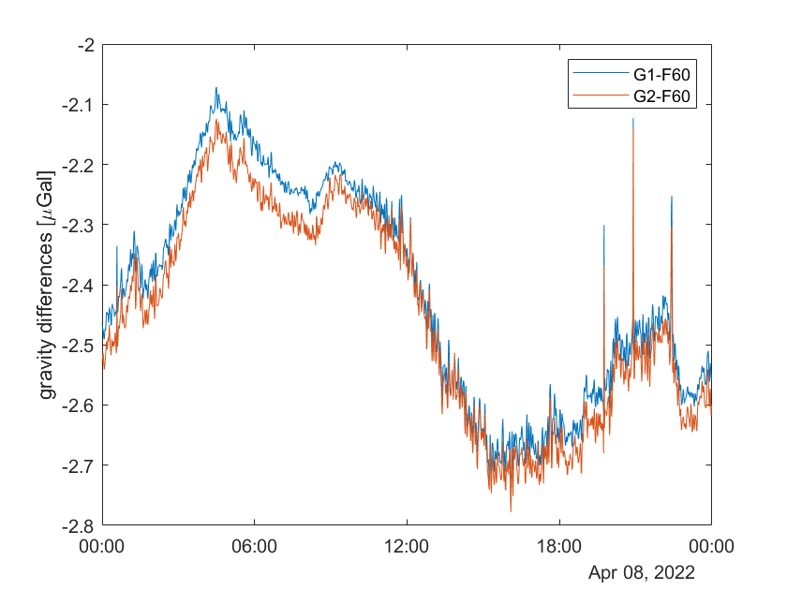
Hydrology
Significant raining event on April 8th
Gravity trend as expected, but there are also other factors involved
Fig. 37: soil moisture and gravity on April 8th

Slide 52


Hydrology
Fig. 38: Comparison of soil moisture (Solidus 1, both probes) and gravity over the month of April

Slide 53

Hydrology
Fig. 39: Comparison of soil moisture (Solidus 1, both probes) and gravity over the year

Slide 54

Hydrology
Fig. 40: Scatter plot of soil mositure and gravity residuals

Slide 55

Hydrology
Fig. 41: results after fitting a scale

Slide 56

Hydrology
Fig. 42: Precipitation in mm/hour

Slide 57

GRACE

Slide 58
GRACE
GRACE Follow-On data up to degree 96 without filtering from ICGEM
Monthly solution only up to October
Adding of degree 1 coefficients and replacing C2,0 and C3,0 from the GRACE Technical Notes #13 and #14 of the NASA GRACE documentation

Slide 59


GRACE
Fig. 43: Radius = 1000 km (above); Radius = 600 km (bottom) almost no change

Slide 60



GRACE
Fig. 44: $L_{max}$ = 96 (above) ; $L_{max}$ = 10 (bottom) The error increases with increasing Grad

Slide 61



GRACE
Fig. 45: with love number (above) ; without love number (middle) difference (bottom)

Slide 62

GRACE
Fig. 46: Comparison of gravity residuals from SG(daily mean) and GRACE/GRACE FO

Slide 63

GRACE
Fig. 47: Comparison of gravity residuals, GRACE, soil mositure and precipitation over full year

Slide 64
Outlook
Comparing GRACE data and gravity over longer time period, perhaps with daily GRACE solutions
Try to explain remaining timeseries:
inner Earth gravity model
Find a good model that connects SM and gravity residuals
Investigate remaining frequencies

Slide 65
References
Neumeyer, Barthelmes, Dierks, et al. Combination of temporal gravity variations resulting from superconducting gravimeter (SG) recordings, GRACE satellite observations and global hydrology models. J Geodesy 79, 573–585 (2006). https://doi.org/10.1007/s00190-005-0014-8

Slide 66

Additional slides - Atmospheric press.
Fig.16: Pressure series at the hut after filtering

Slide 67

Additional slides – Remaining frequ.
Fig. 27: Lomb-scargle analysis of gravity series of sensor 2

Slide 68

Additional slides – Remaining frequ.
Fig. 28: Full Lomb-scargle analysis for sensor 1

Slide 69

Additional slides - Remaining frequ.
Fig. 28: Full Lomb-scargle analysis for sensor 1
Notes:
- Inverse Depiction!!!

Slide 70

Additional slides - Remaining frequ.
Fig. 29: Gravity series before and after frequency elimination
Eliminated frequencies: 354 days, 1 day, 1 lunar day, ½ day, ½ lunar day

Slide 71

Additional slides - Remaining frequ.
Fig. 31: Comparison of gravity series before and after frequency elimination

Slide 72

Additional slides – differences between sensors
Fig.: differences between sensors with new calibration coefficient

